Slide 1


JAVA INTERVIEW BOOTCAMP
Lecture 14

Slide 2

Today’s Agenda
Array Initialization
Initializing Array References
Array Reference Assignments
Anonymous Array
Popular Interview Questions

Slide 3
Array Initialization
There are several ways to initialize an array:
1. Initialization after declaration
int [ ] arr=new int[5];
arr[0]=10;
arr[1]=20;
arr[2]=30;
arr[3]=40;
arr[4]=50;

Slide 4
Array Initialization
2. Using Initializer List
An initializer list can be used to instantiate and fill an array in one step
The values are delimited by braces and separated by commas
Examples:
Size is not allowed to be mentioned
2. Size is determined by number of elements in the list
int[] arr = new int[ ]{10,20,30,40,50};
char[] vowels = new int[ ]{'A', ‘E', ‘I', ‘O', ’U'};

Slide 5
Array Initialization
3. Using Initializer List Shortcut
If we are providing initializer list along with array reference declaration then we can even drop the keyword new
Examples:
int[] arr = {10,20,30,40,50};
char[] vowels = {'A', ‘E', ‘I', ‘O', ’U'};

Slide 6
Array Initialization
4. Another Way To Provide Initializer List
We also can provide initializer list after array reference declaration , but then new keyword is compulsory
Examples:
Syntax Error! The keyword new is required if we use initializer list after array reference declaration
int[] arr ;
arr= new int[ ]{10,20,30,40,50};
char[] vowels ;
vowels= new char[]{'A', ‘E', ‘I', ‘O', ’U'};
int[] arr ;
arr= {10,20,30,40,50};

Slide 7
Initializing Array Of References
Suppose we create an array of three Animals as follows:
We have one array object on the heap, with three null references of type Animal, but we don’t have any Animal objects.

Slide 8

Initializing Array Of References
The next step is to create some Animal objects and assign them to index positions in the array referenced by pets:
This code puts three new Animal objects on the heap and assigns them to the three index positions (elements) in the pets array.

Slide 9
Shortcut Way
Like primitives we can also initialize array of references:

Slide 10
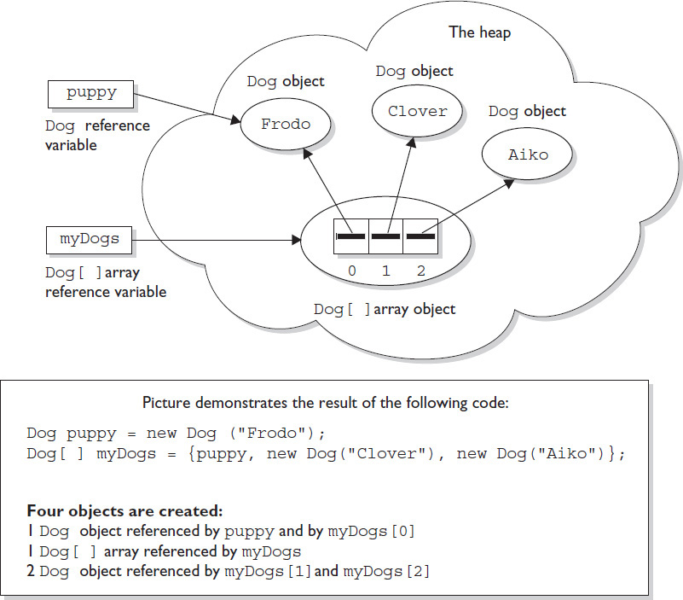
Memory Diagram

Slide 11
Shortcut Way With 2D Arrays
You can also use the shortcut syntax with multidimensional arrays, as follows:
How many objects are created by the above code ?
Answer: 4

Slide 12
Popular Interview Question
Draw the memory diagram for the following code and also find number of objects created ?

Slide 13
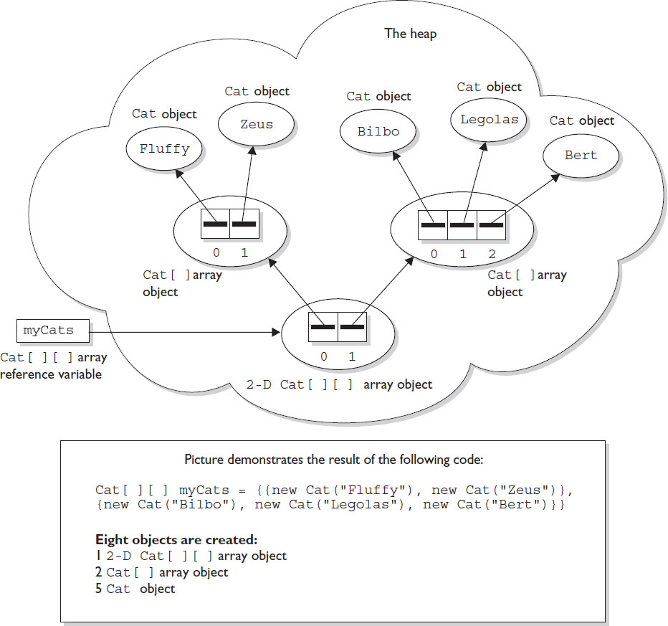
Memory Diagram

Slide 14
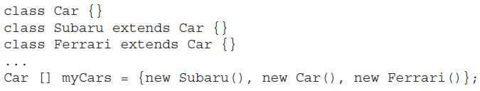
Will this code compile ?
Yes it will. Car array is nothing more than Car reference variables. So anything that can be assigned to a Car reference variable can be legally assigned to a Car array element.

Slide 15
Interface Reference Array
interface Sporty{
void beSporty();
}
class Ferrari extends Car implements Sporty{
}
class RacingShoe extends AthleticShoe implements Sporty{
}
class GolfClib{}
class TestSportyThings{
public static void main(String [] args){
Sporty [] sportThings=new Sporty[3];
sportyThings[0]=new Ferrari();
// OK
sportyThings[1]=new RacingShoe();
//OK
sportyThings[2]=new Golf();
//ERROR
}
}

Slide 16
Array Reference Assignments
If you declare an int array, the reference variable you declared can be reassigned to any int array (of any size), but the variable cannot be reassigned to anything that is not an int array, including an int value.
Remember, all arrays are objects, so an int array reference cannot refer to an int primitive.

Slide 17
Popular Interview Question
Consider the following statement:
int [ ] arr={10,20,30};
char[ ] vowels={‘A’, ‘E’, ‘I’, ‘O’, ‘U’};
Predict the output for each of these lines:
int [ ] brr=arr;
// OK . Both are of same type
int [ ] vowels2=vowels;
//Syntax Error! Incompatible Types
char[ ] vowels3=vowels;
//OK . Both are of same type
arr=10;
//Syntax Error! Incompatible Types

Slide 18
Array Reference Assignments
Arrays that hold object references, as opposed to primitives, aren’t as restrictive.
Just as we can put a Honda object in a Car reference (assuming Honda extends Car), we can assign an array of type Honda to a Car array reference variable as follows:
Cars[] c;
Honda [] h=new Honda[5];
c=h;
// Perfectly Ok , because Honda is a type of Car
Beer [] b=new Beer[5];
c=b;
// Error, because Beer is not a type of Car

Slide 19
Array Reference Assignments
The rules for array assignment apply to interfaces as well as classes.
An array declared as an interface type can reference an array of any type that implements the interface.
Remember, any object from a class implementing a particular interface will pass the IS-A (instanceof) test for that interface.

Slide 20
Array Reference Assignments
For example, if Box implements Foldable, the following is legal:
Foldable[] folders;
Box [] boxes=new Box[5];
folders=boxes;
// Perfectly Ok , because Box implements Foldable, so a Box IS A Foldable

Slide 21
Array Reference Assignments
Array Type | Allowed Elements
Primitive | Element of any type which is implicitly convertible to the declared type
Non Abstract class | Element of it’s own type or derived type
Abstract class | Only sub-class objects
Interface | It’s implementation class objects

Slide 22
Popular Interview Question
Which of the following are implicit conversions:
int →char
//No
char→int
//Yes
int →long
//Yes
int [ ] →long[ ]
// No
float→int
// No
float→double
//Yes
float[ ]→double[ ]
//No
Integer→Number
//Yes
String→Object
//Yes
String[ ]→Object[ ]
//Yes

Slide 23
Using The length Property
In Java every array has a property called length which returns the size of the array i.e. number of elements present in the array.
It is a final instance variable available in the internal class created by Java for every array.
int[] array = new int[4];
System.out.println("The size of the array is " + array.length);

Slide 24
length Vs length()
array.length : length is a final variable applicable for arrays. With the help of length variable, we can obtain the size of the array.
string.length() : length() is a method which is applicable for string objects. It returns the number of characters presents in the string.

Slide 25
length Vs length()
int[] array = new int[4];
System.out.println("The size of the array is " + array.length);
String str = “SCA";
System.out.println("The size of the String is " + str.length());
Output:
The size of the array is 4
The size of the String is 3

Slide 26
Popular Interview Questions
What is the output of the following code?
int[ ] arr=new int[3];
System.out.println(arr.length());
Output:
Syntax Error!
Conclusion:
The method length() is not applicable to arrays

Slide 27
Popular Interview Questions
What is the output of the following code?
String name=“Sachin”;
System.out.println(name.length);
Output:
Syntax Error!
Conclusion:
The property length is only applicable to arrays and not
objects

Slide 28
Popular Interview Questions
Consider the following statement:
String[ ] weekdays={“Sunday”, “Monday”, “Tuesday”};
Predict the output for each of these lines:
System.out.println(weekdays.length);
3
System.out.println(weekdays.length( ));
Syntax Error!
System.out.println(weekdays[0].length());
6
System.out.println(weekdays[0].length);
Syntax Error!

Slide 29
Popular Interview Questions
What is the output of the following code?
int [ ][ ]arr={ {10,20,30},{40,50,60}};
System.out.println(arr[0].length);
Output:
3
Conclusion:
For a 2D array , the expression arr[i].length returns the
size of the array pointed by the ith reference i.e size of
row i

Slide 30
Popular Interview Questions
What is the output of the following code?
int [ ][ ]arr={ {10,20,30},{40,50,60}};
System.out.println(arr.length);
Output:
2
Conclusion:
For a 2D array , the length property returns the size of
array of references i.e. the row size.

Slide 31
Popular Interview Questions
What is the output of the following code?
int [ ][ ]arr={ {10,20,30},{40,50,60}};
System.out.println(arr[0][0].length);
Output:
Syntax Error!
Conclusion:
The property length is not available for primitive values and
arr[0][0] is a primitive value.

Slide 32
Anonymous Arrays
Anonymous arrays in Java is an Array without any name
The purpose of using an Anonymous array is to just create, initialize and use it.
Since it doesn't has any name we can not reuse it.

Slide 33
Using Anonymous Arrays
anonymous int array : new int[] { 1, 2, 3, 4};
anonymous String array : new String[] {"one", "two", "three"};
anonymous char array : new char[] {'a', 'b', 'c');

Slide 34
Using Anonymous Arrays
class Sample {
public static void main(String[] args) {
System.out.println("first total of numbers: " + sum(new int[]{ 1, 2,3,4}));
}
public static int sum(int[] arr){
int total = 0;
for(int i: arr){
total = total + i;
}
return total;
}
}

Slide 35
Popular Interview Questions
1. What lines will compile without errors? (Choose all that apply.)
A. Object obj = new Object();
B. Object[] obj = new Object();
C. Object obj[] = new Object();
D. Object[] obj = new Object[];
E. Object[] obj = new Object[3]();
F. Object[] obj = new Object[7];
G. Object obj[] = new Object[];
H. Object obj[] = new Object[3]();
I. Object obj[] = new Object[7];
J. Object[8] obj = new Object[];
K. Object[3] obj = new Object[3]();
L. Object[7] obj = new Object[7];
M. Object obj[] = new {new Object(), new Object()};
N. Object obj[] = {new Object(), new Object()};
O. Object obj[] = {new Object[1], new Object[2]};
Correct Answer:
A,F,I,N,O

Slide 36
Popular Interview Questions
2. What is the output of the following code segment?
A. One Two Three
B. Three Two One
C. A compile time error will be generated.
D. A runtime exception will be thrown.
Correct Answer:
D

Slide 37

Popular Interview Questions
3. What is the output of the following code segment?
A. One Two Three
B. Three Two One
C. A compile time error will be generated.
D. A runtime exception will be thrown.
Correct Answer:
A

Slide 38
Popular Interview Questions
4. What is the output of the following code segment?
A. Length: 4
B. Length: 5
C. Length: 100
D. A compile time error will be generated.
E. A runtime exception will be thrown.
Correct Answer:
B

Slide 39
Popular Interview Questions
5. What line will produce a compiler error?
A. double[][] numbers;
B. double[][][] numbers;
C. double[][] numbers = {{1,2,3},{7,8,9},{4,5,6}};
D. double[][] numbers = {{1,2,3},{7,8},{4,5,6,9}};
E. double[][][] numbers = new double[7][][];
F. double[][][] numbers = new double[][][];
G. double[][][] numbers = new double[7][3][2];
Correct Answer:
F

Slide 40
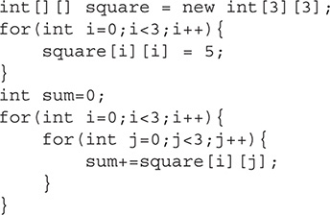
Popular Interview Questions
6. What is the value of the variable sum at the end of this code segment?
A. 0
B. 5
C. 10
D. 15
E. 20
F. 25
G. 30
H. 35
I. 40
J. 45
K. 50
L. It will generate a compiler error.
Correct Answer:
D

Slide 41

Popular Interview Questions
7. The following code segment is valid. true or false?
A. True
B. False
Correct Answer:
A

Slide 42
Popular Interview Questions
8. What is an anonymous array?
A. An array that does not name its object reference
B. An array that does not name its type
C. A way to declare and initialize an array at the same time
D. A way to initialize arrays without a loop
Correct Answer:
A

Slide 43
Popular Interview Questions
9. Which array declaration is not legal?
A. int[][] scores = new int[5][];
B. Object [][][] cubbies = new Object[3][0][5];
C. String beans[] = new beans[6];
D. java.util.Date[] dates[] = new java.util.Date[2][];
Correct Answer:
C

Slide 44
Popular Interview Questions
10. Which of the following references the first and last element in a non-empty array?
A. trains[0] and trains[trains.length]
B. trains[0] and trains[trains.length - 1]
C. trains[1] and trains[trains.length]
D. trains[1] and trains[trains.length - 1]
Correct Answer:
B

Slide 45
Popular Interview Questions
11. What is the output of the following code ?
int [] arr=new int[]{};
System.out.println(arr.length);
A. Compile Time Error
B. 0
C. Exception
D.1
Correct Answer:
B

Slide 46
Popular Interview Questions
12. What is the output?
String[][] matrix = new String[1][2];
matrix[0][0] = "Don't think you are, know you are.";
matrix[0][1] = "I'm trying to free your mind Neo";
matrix[1][0] = "Is all around you ";
matrix[1][1] = "Why oh why didn't I take the BLUE pill?";
Will print all 4 strings
Syntax Error
Exception
No Output
Correct Answer:
C

Slide 47
Popular Interview Questions
13. Which is the first line to prevent this code from compiling and running without error?
char[][] ticTacToe = new char[3,3]; // r1
ticTacToe[1][3] = 'X'; // r2
ticTacToe[2][2] = 'X';
ticTacToe[3][1] = 'X';
System.out.println(ticTacToe.length + " in a row!"); // r3
A. Line r1
B. Line r2
C. Line r3
D. None of the above
Correct Answer:
A

Slide 48
Popular Interview Questions
14. How many dimensions does the array reference moreBools allow?
boolean[][][] bools, moreBools;
A. One dimension
B. Two dimensions
C. Three dimensions
D. None of the above
Correct Answer:
C

Slide 49
Popular Interview Questions
15. What is a possible output of the following code?
String[] strings = new String[2];
System.out.println(strings);
A. [null, null]
B. [,]
C. String class toString( ) gets called
D. None of the above
Correct Answer:
D

Slide 50
Popular Interview Questions
16. What is the output ?
class Test{
static int[][] game = new int[6][6];
public static void main(String[] args) {
game[3][3] = 6;
Object[] obj = game;
obj[3] = "X";
System.out.println(game[3][3]);}}
A. X
B. The code does not compile.
C. The code compiles but throws a NullPointerException at runtime.
D. None of the above.
Correct Answer:
D

Slide 51
Popular Interview Questions
17. Which of these four array declarations produces a different array than the others?
A. int[][] nums = new int[2][1];
B. int[] nums[] = new int[2][1];
C. int[] nums[] = new int[][] { { 0 }, { 0 } };
D. int[] nums[] = new int[][] { { 0, 0 } };
Correct Answer:
D

Slide 52
Popular Interview Questions
18. What is the output of the following?
String[][] listing = new String[][] { { "Book" }, { "Game", "29.99" } };
System.out.println(listing.length + " " + listing[0].length);
A. 2 1
B. 2 2
C. The code does not compile.
D. The code compiles but throws an exception at runtime.
Correct Answer:
A

Slide 53
Popular Interview Questions
19. Which of these four array references can point to an array that is different from the others?
A. int[][][][] nums1a, nums1b;
B. int[][][] nums2a[], nums2b;
C. int[][] nums3a[][], nums3b[][];
D. int[] nums4a[][][], numbs4b[][][];
Correct Answer:
B

Slide 54
Popular Interview Questions
20. What is the output of the following when run as
java Count "1 2“ ?
public class Count { public static void main(String target[]) { System.out.println(target.length); } }
A. 0
B. 1
C. 2
D. The code does not compile.
Correct Answer:
B

Slide 55
Popular Interview Questions
21. What is the output of the following code ?
class Test{
public static void main(String[] args) {
int[]arr={10,20};
int []brr={30,40};
System.out.println(arr.equals(brr));
}
}
A. false
B. Compile Time Error
C. Exception
D. None of the above
Correct Answer:
A

